Slide 1


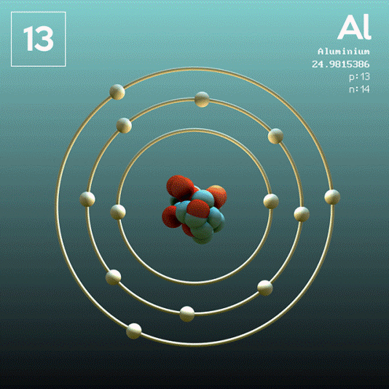
DEPARTMENT OF PHYSICS AND NANOTECHNOLOGY
SRM INSTITUTE OF SCIENCE AND TECHNOLOGY
18PY103J – Physics: Semiconductor Physics
Module-I, Lecture-2
Quantum Free Electron Theory and band Theory
18PYB103J Module-I Lecture-1

Slide 2
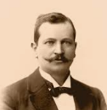
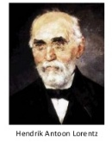
Classical Free Electron Theory of Metals
Free Electron Theory
The electron theory of materials is to explain the structure and properties of solids through their electronic structure.
It also gives information about bonding in solids, energy levels in metals and cohesive & repulsive forces in metals.
Drude
Development of Free Electron Theory
The Classical free electron theory [Drude and Lorentz]
It is a macroscopic theory, through which free electrons in lattice and it obeys the laws of classical mechanics. Here the electrons are assumed to move in a constant potential.
Drude
18PYB103J Module-I Lecture-1

Slide 3
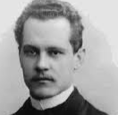

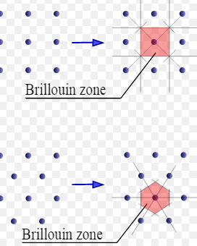
Classical Free Electron Theory of Metals
The Quantum free electron theory [Sommerfeld Theory]
It is a microscopic theory, according to this theory the electrons in lattice moves in a constant potential and it obeys law of quantum mechanics.
Brillouin Zone Theory [Band Theory]
Bloch developed this theory in which the electrons move in a periodic potential provided by periodicity of crystal lattice. It explains the mechanisms of conductivity, semiconductivity on the basis of energy bands and hence band theory.
18PYB103J Module-I Lecture-1

Slide 4
Classical Free Electron Theory of Metals
Drude Theory
This theory initially proposed by Drude in 1900,and it’s the first theory to explain the electrical conduction in conducting materials and reveals that free electrons are responsible for the electrical conduction.
Free electrons
In certain metals especially in Cu, Ag and Al valence electrons are so weakly attached to the nuclei they can be easily removed or detached such electrons are called as free electrons.
But all the valence electrons in the metals are not free electrons.
18PYB103J Module-I Lecture-1

Slide 5
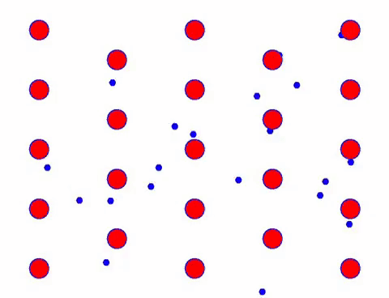
Classical Free Electron Theory of Metals
Concept of Classical Free electron Theory
According to this theory, metals consists of positive ions fixed in lattice and negative ions wander freely within the boundaries of the metal.
As they are responsible for conductivity called as Conduction electrons
This cloud of free electrons are called as electron gas
They differ fro ordinary gas in two aspects
Free electron gas is charged while molecules of ordinary gases are neutral
Concentration of electron is > ordinary gas concentration
18PYB103J Module-I

Slide 6
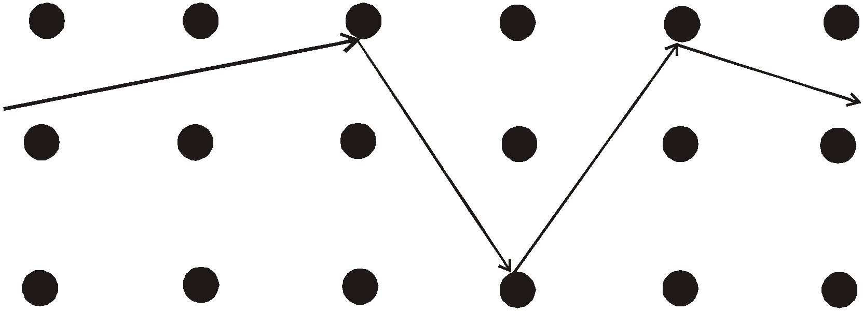
Classical Free Electron Theory of Metals
The time ‘τ’ is known as the relaxation time and it is defined as the time taken by an electron between two successive collisions. That relaxation time is also called mean free time [or] collision time.
Electrons are assumed to achieve thermal equilibrium with their surroundings only through collision. These collisions are assumed to maintain local thermodynamic equilibrium in a particularly simple way.
Figure 2 | Trajectory of a conduction electron
18PYB103J Module-I Lecture-1

Slide 7
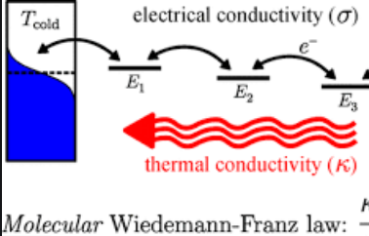
Classical Free Electron Theory of Metals
Success of classical free electron theory:
(1). It verifies Ohm’s law.
(2). It explains the electrical and thermal conductivities of metals.
(3). It derives Wiedemann – Franz law. (i.e., the relation between electrical conductivity and thermal conductivity)
(4). It explains optical properties of metals.
Introduction to Classical free electron theory
18PYB103J Module-I Lecture-1

Slide 8
Classical Free Electron Theory of Metals
Drawbacks of classical free electron theory:
The phenomena such a photoelectric effect, Compton effect and the black body radiation couldn’t be explained by classical free electron theory.
Cannot explain the electrical conductivity of semiconductors and Insulators.
Ferromagnetism cannot be explained by theory.
https://www.youtube.com/watch?v=ttdtdLfn9HU&ab_channel=Aftertutor
18PYB103J Module-I Lecture-1

Slide 9
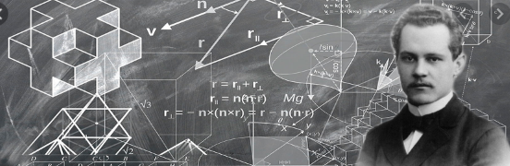
QUANTUM FREE ELECTRON THEORY
Classical free electron theory could not explain many physical properties.
In 1928, Sommerfield developed a new theory applying quantum mechanical concepts and Fermi-Dirac statistics to the free electrons in the metal. This theory is called quantum free electron theory.
Classical free electron theory permits all electrons to gain energy. But quantum free electron theory permits only a fraction of electrons to gain energy.
18PYB103J Module-I Lecture-1

Slide 10

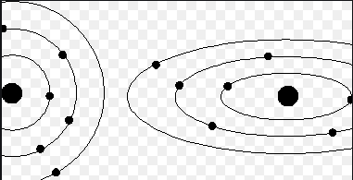
Quantum Free Electron Theory of Metals
According to Quantum mechanics moving particles has some sort of wave motion
Then wavelength λ=h/p (De-Broglie wavelength)
To characterize moving particle having wave motion-(ψ)- wavefunction is introduced
According to quantum theory of free electrons energy of a free electron is given by
En = n²h²/8mL²
• According to quantum theory of free electrons the electrical conductivity is given by
σ = ne²T/m
18PYB103J Module-I Lecture-1

Slide 11
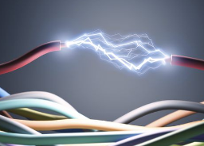
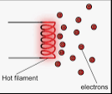
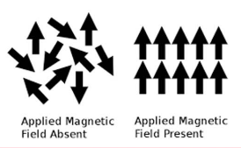
Quantum Free Electron Theory of Metals
MERITS OF QUANTUM FREE ELECTRON THEORY
1. It successfully explains the electrical and thermal conductivity of metals.
2. We can explain the Thermionic phenomenon.
3. Temperature dependence of conductivity of metals can be explained by this theory.
4. It can explain the specific heat of metals.
5. It explains magnetic susceptibility of metals.
18PYB103J Module-I Lecture-1

Slide 12
Quantum Free Electron Theory of Metals
DEMERITS OF QUANTUM FREE ELECTRON THEORY
It is unable to explain the metallic properties of exhibited by only certain crystals
Failed to give difference of metals/semiconductors/ insulators
3. It is unable to explain why the atomic arrays in metallic crystals should prefer certain structures only
18PYB103J Module-I Lecture-1

Slide 13
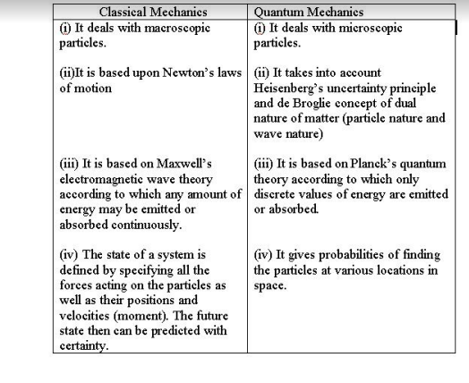
Comparison

Slide 14
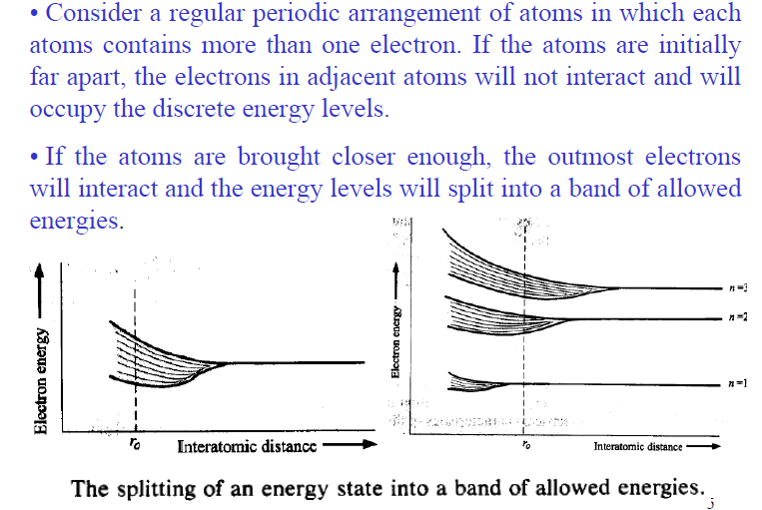
Band Theory
Energy bands in solids
18PYB103J Module-I Lecture-2

Slide 15
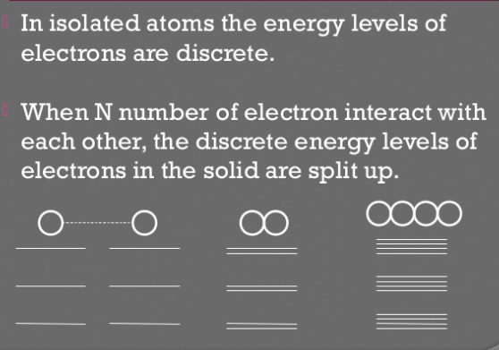

Slide 16
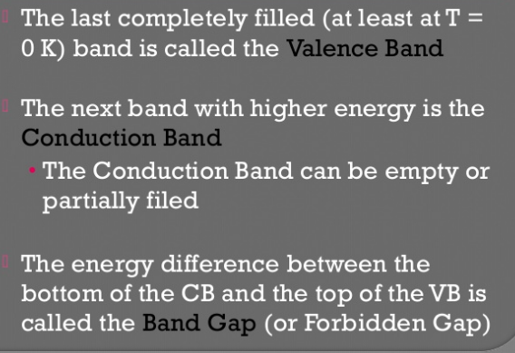

Slide 17
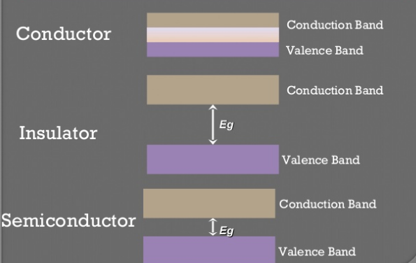

Slide 18
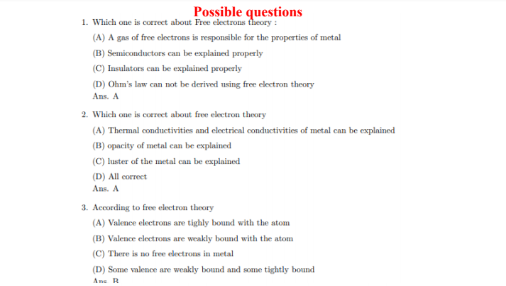
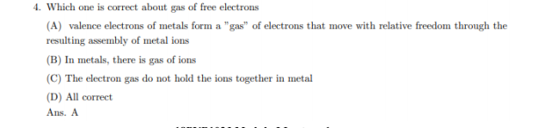

Slide 19
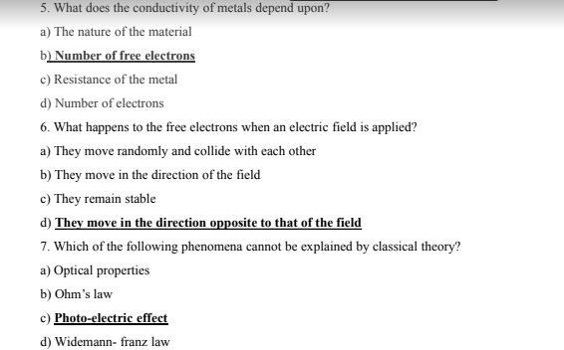
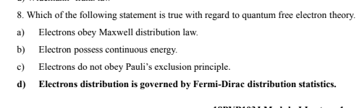

Slide 20
Thank you

